Slide 1
Restaurant Tourist Traps
A Restaurant Pricing Analysis
Presented By:
Joshua Mu
Jorge Neri
Patricia Rollins
Brian Rowe

Slide 2
Our Motivation
Our goal was to determine any correlations between the price ranges of food places based on proximity to popular tourist attractions.

Slide 3
Research & Analysis
Questions To Answer:
Do tourist traps exist around famous landmarks? If so how much more expensive are they than restaurants 5 or more miles away?
Is the absolute distance from a tourist attraction a better indicator of price range than relative distance?
Does the possibility of increased prices at these tourist traps influence the ratings?

Slide 4
Our Steps For Analysis
Gathered and pulled data to create a workable dataset
Cleaned the data to condense it and remove extraneous information
Reviewed the data and made some basic observations through initial coding and graphing
Conducted further analysis and created more graphs
Derived our conclusions using research results

Slide 5
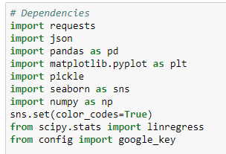
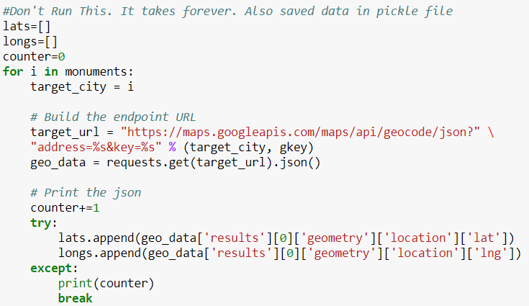
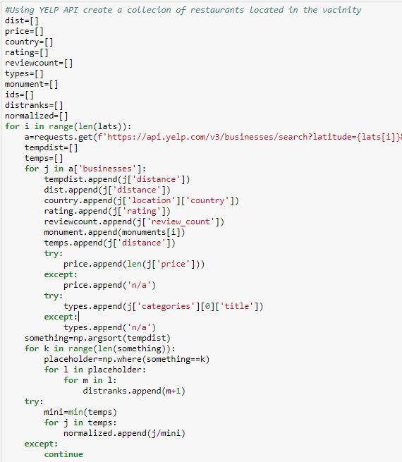
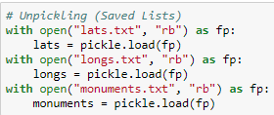
Gathering The Data

Slide 6
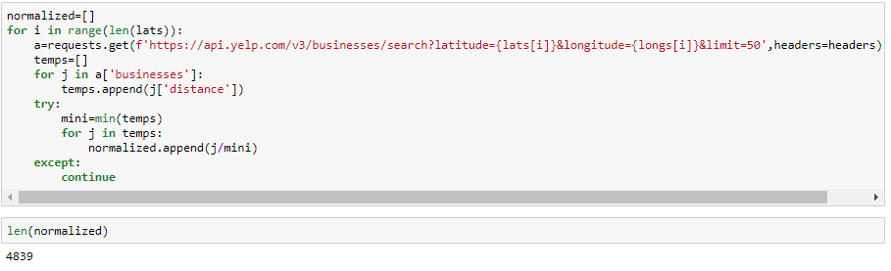
Cleaning & Preparing Data

Slide 7
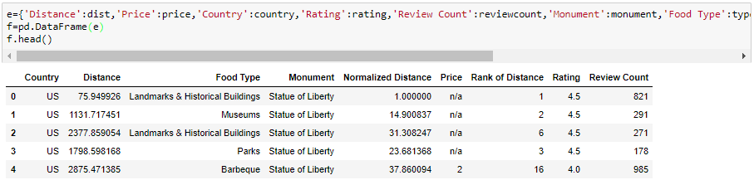
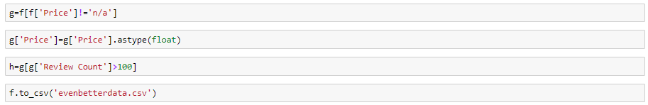
Cleaning & Preparing Data

Slide 8
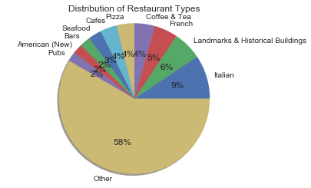
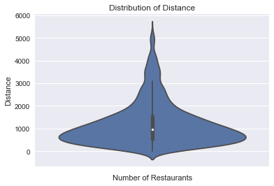
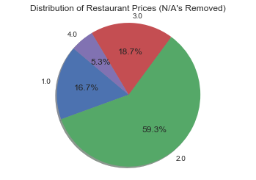
Our Initial Observations
Notes:
These graphs show the demographics of the restaurants we surveyed. Restaurant types was a bit difficult to represent as there were 236 different labels. We initially wanted to see if perhaps Italian restaurants were in general more expensive than French restaurants but because of the many different labels we decided not to pursue it. From the restaurant price chart you can see that about 3/4ths of the restaurants were rated as either a 2 or 3. Finally, this fancy looking graph is called a violin chart. Basically the outer shape is the overall distribution of the distances, the inner points are the inner 95% of the data, and the dot in the center is the median distance.

Slide 9
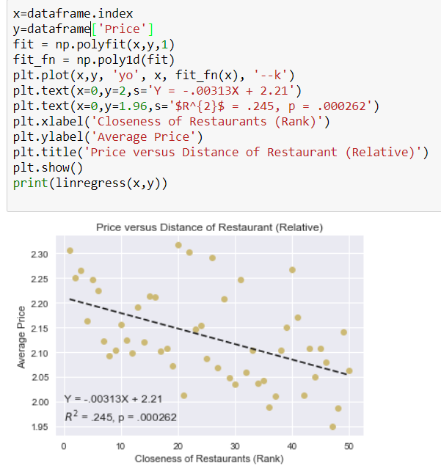
Data Analysis Coding
Sample Code for Plotting Graphs
Notes:
We moved onto our original problem of relating distance to price and to help represent our findings, we used googlefu to help us graph lines of best fit. Fit and fit_fn essentially allow us to create the line of best fit and linregress helped us know the components of the line of best fit as well as the r^2 and p values. For those who don’t remember, R^2 is basically how correlated the two variables are, while the p score tells us if there even is a statistically relevant correlation. We want our p score to be less than .05 and our r^2 to be as high as possible.

Slide 10
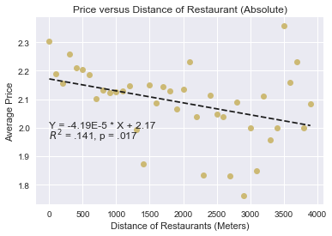
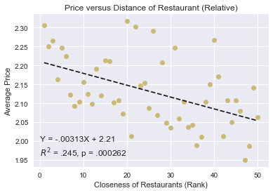
Other Graphing Results
Price vs. Distance
Notes:
So here are our main results. First lets examine the graph on the left. To create this one we grouped restaurants between 0 and 100 meters, 100 and 200 and so on. As you can see it gives us reasonable results as the p score is indeed less than .05 but the R^2 shows us that it’s not extremely predictive as you can see it falls off heavily at higher distances which also had a smaller sample size.
In comparison, the graph on the right grouped the restaurants based on relative distance. Essentially the closest restaurant to each monument was in the same group, the 2nd closest were all in the same group and so on. Not only do these groups all have similar sample size, but the R^2 value is higher implying it is more predictive and p score is miniscule which means there is almost a real relationship.
Basically, the left graph says a 1500 meter away restaurant is likely to be cheaper than a 100 meter restaurant, and the right graph says the 15th closest restaurant is likely to be cheaper than the closest restaurant but also with more certainty.

Slide 11
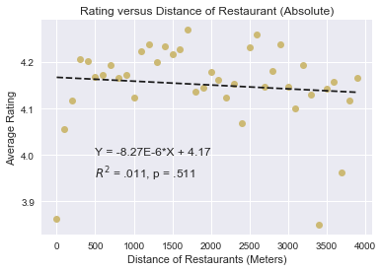
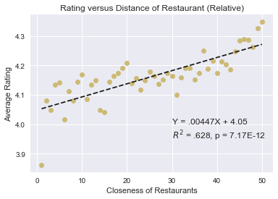
Other Graphing Results
Ratings vs. Distance
Notes:
We also tried to analyze potential confounding variables. Perhaps closer restaurants are higher quality and thus deserving of their statistically higher prices.
Again let’s examine the left graph first. Here we can see that there’s basically no relationship between the distance and the rating. With an R^2 of .011 there’s essentially 0 predictability, and the p score reaffirms that there’s no relationship.
The right graph, on the other hand, is pretty decisive. Restaurants that are closer than their competitors are often rated poorly.
As such, despite closer restaurants being more expensive, they also serve worse food.

Slide 12
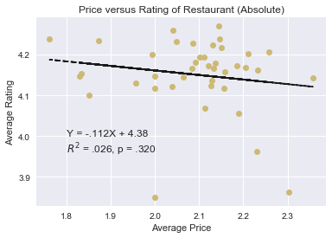
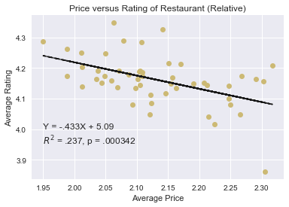
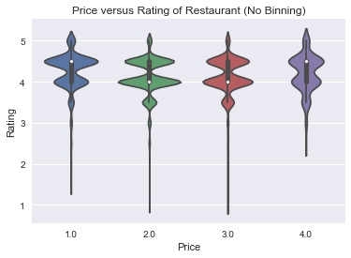
Other Graphing Results
Price vs. Ratings
Notes:
Finally we wanted to see if there was a relationship between price and rating. Maybe people don’t like more expensive food.
Once again, we can see the superiority of the relative distance binning technique as the right graph essentially tells us nothing.
The right graph, on the other hand, tells us that perhaps that hypothesis is right as it shows us that there is a relationship between price and rating.

Slide 13
Our Conclusions
Do tourist traps exist around famous landmarks?
Yes
Is the absolute distance from a tourist attraction a better indicator of price range than relative distance?
No
Does the possibility of increased prices at these tourist traps influence the ratings?
Maybe
Notes:
So ultimately what can we say about our original questions:
Yes there are tourist traps in the sense that restaurants relatively closer to monuments tend to be more expensive. However, we have not established causation. For all we know, more expensive restaurants can cause monuments to spontaneously appear.
Using our graphs we also pretty definitively proved that absolute distance is not as great a factor as the relative distance compared to other close by restaurants.
Finally, we we found that these tourist traps generally had lower ratings but we weren’t able to say definitively why. While there was a slight negative correlation between price and rating, it is not enough to say for sure.

Slide 14
Analysis Post Mortem
Our Limitations:
Different currencies existed and had to be normalized
Assumed all restaurants were unique
Information available based on ratings and pricing pulled through the Yelp API
Only famous landmark locales were used
Assumed ratings and pricing were consistent with all cuisines
Notes:
We observed that the dataset had different currencies, so decided to translate the price symbols to a number ranking
We assumed that no restaurants appeared more than once
Our data is primarily based on the structure of Yelp’s API
We obtained a list of 150 “most famous” sites and determined this list was comprehensive enough to seek information to support our theory/hypothesis
Maybe people have higher standards for more expensive foods. We decided to assume against this idea.

Slide 15
Analysis Post Mortem
Our Challenges:
Verifying if any correlations exist using just a list of famous monuments
Analysis from first dataset created unexpected and inconclusive results
Determining which graphs to use to depict the analysis results
Notes:
We debated on whether or not we should expand our tourist attraction list and not just use monuments. We did find another list from a reputable site, but due to time constraints, decided to stay with the original.
Information was pulled more than once and initial graphing helped indicate a need to change the dataset and improve on accuracy of results
We initially looked at box plots and scatter plots, but later discussed other types of graphs that would best show the correlations of data and analysis

Slide 16
Analysis Post Mortem
Our Additional Questions:
How would the analysis have changed if other tourist attractions were added?
Would the results have changed if the distance radius was larger?
Would the results have changed if the number of restaurants were increased from 50 to 100?
If we had more time to explore the relationship between proximity and restaurant ratings, would the results have been different?
Notes:
As stated we decided to stick with landmarks, but what about other tourist attraction?
The distance radius used was the default set by Yelp. What if we increased this radius?
We initially used 20 restaurants to start when pulling data for the first dataset. Then increased this amount to 50 and noticed a change in results. What if the amount increased to 75?

Slide 17

Questions?

